Slide 1
Django-admin & manage.py commands

Slide 2
Development Server
Django project
Development server
Client

Slide 3
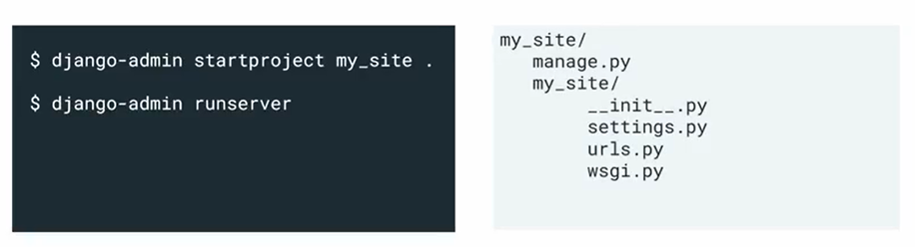
Django project

Slide 4
Django-admin
Manage.py

Slide 5
Can use both
Subtle differences
Choice of usage

Slide 6
1
django-admin and manage.py
2
Perform administrative tasks

Slide 7
Django-admin
Ready to use admin interface

Slide 8
Located in the
Scripts folder
Executed from
Inside the terminal

Slide 9
Manage.py
Local version of Django-admin

Slide 10
Django-admin.py
Automatically Installed located on system path Activate virtual environment

Slide 11
manage.py
Automatically created specific to virtual environment points to settings.py

Slide 12
Django-admin
Manage.py

Slide 13
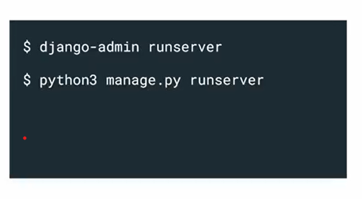
Django Project

Slide 14
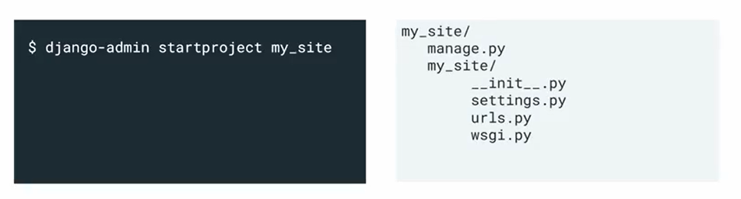
Django Project

Slide 15
Uses project name
Current working directory
Optional destination

Slide 16
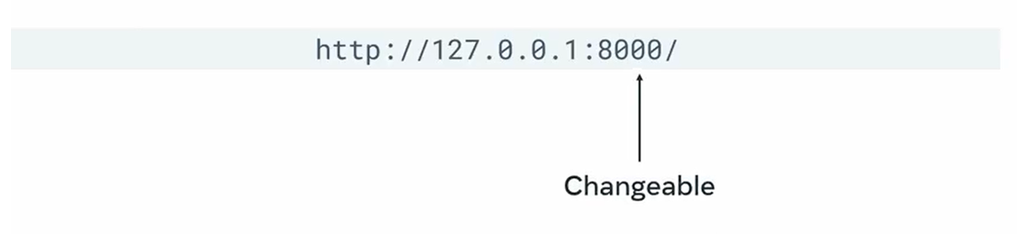
Development web server
Changeable

Slide 17
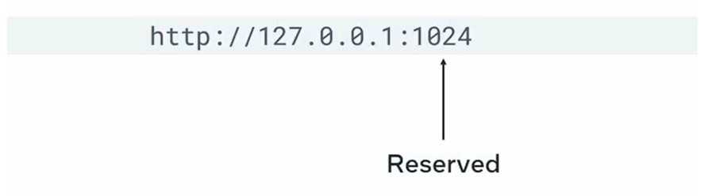
Development web server
Reserved

Slide 18
Automatic reload
No restart needed

